Slide 1
Doing Data Science
Unit 10 Machine Learning – 2
Dr. Jacquie Cheun
Data Science @ SMU

Slide 2
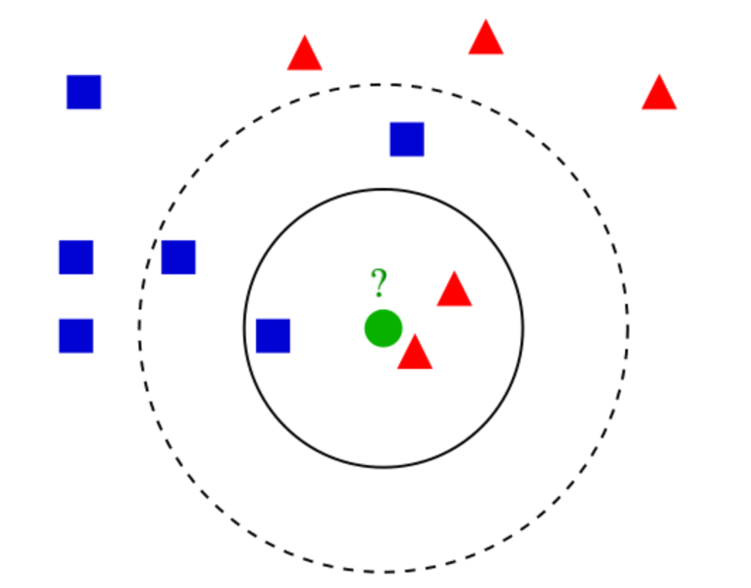
K-Nearest Neighbors (k-NN) .. You are the average of your k closest friends
Non-parametric: no speculation about the model function f before training the model (its determined from data)
Lazy “instance based” learner: no training required but may take more time predicting.
Intuition: consider the most similar items in terms of attributes, and give the unlabeled item the majority vote label. (in case of a tie, randomly select from top labels).

Slide 3
K-NN algorithm
How to define similarity or closeness?
***Standardization: scale of attributes matters (e.g., age vs income --> income would dominate due its size)
Various measures exist such as:
Euclidean distance: for variables on the same scale
Cosine distance: for real-valued vectors,
(cosine angle between vectors)
-1 (exact opposite), 1 (exact same)
Jaccard similarity: distance between a set of objects and how similar those two sets are (intersection over union)

Slide 4
Use Jaccard when duplication does not matter and Cosine where duplication matters. See https://towardsdatascience.com/overview-of-text-similarity-metrics-3397c4601f50
Plagiarism → Cosine
Mirror sites → Jaccard
Product Descriptions ??
How many neighbors to look at? --> the value “k”
Typically k = square-root of n (number of instances)
Use cross-validation to tune the value of k:
i) Split training data into n folds or segments
ii) Training on n-1 folds and test on hold-out fold
iii) Pick whichever k that gives the lowest error across all iterations

Slide 5
High values of k prevent overfitting but if the value is too high it can be biased
E.g., k = N, all test data would be classified as the mean/mode of training data
kNN modeling assumptions:
i) Data is in a feature space where notion of ‘distance’ makes sense
ii) Training data is classified into two or more classes
iii) Need to choose the value of k = number of neighbors
iv) Observed features and labels are somehow related

Slide 6
kNN application areas:
Impute missing training data
Fraud detection (adapt fast to new data points)
“Similar search”: semantically similar documents or search items
A component in a more complex ensemble classification architecture
See Annoy by Spotify: fast-approximate NN: https://github.com/spotify/annoy
https://erikbern.com/2015/09/24/nearest-neighbor-methods-vector-models-part-1.html

Slide 7
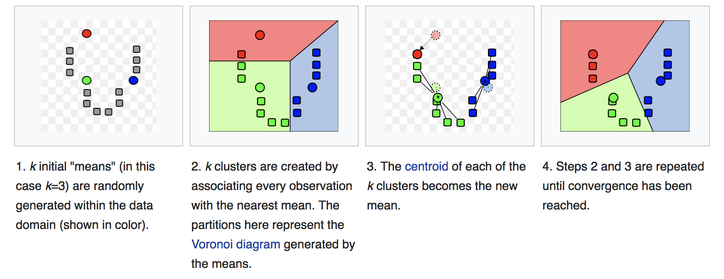
k-Means .. Unsupervised learning
Clustering: Uses unlabeled data
Goals: cluster data points into k groups by creating a centroid for each group
Find the underlying structure of data / create groups or segments of data

Slide 8
k-Means algorithm:
Randomly pick k-centroids in d-space (algorithms exist for initializing centroids that converge more effectively,e.g., kmeans++)
Assign each data point to the closest centroid (using a nearness measure such as Euclidean distance)
Move centroid to the average location of all data points.
Repeat until algorithm converges (i.e., centroids don’t change much)

Slide 9
Problems with k-means
Final cluster configuration depends on initial centroid allocation
Need to choose the value of k (use cross validation, elbow method, et al)
Convergence issues: algorithm can fall into a loop, bouncing back and forth between two solutions (in most practical situations, kmeans converges)
Interpretability can be a problem: sometimes the answer isn’t useful

Slide 10
….however, kmeans is fast compared to other clustering algorithms and has broad applications (customer segmentation, taxonomy construction, etc.
Large scale k-means clustering: see
Scalable K-means by Ranked Retrieval, Google, WSDM’14. https://static.googleusercontent.com/media/research.google.com/en//pubs/archive/42853.pdf

Slide 11
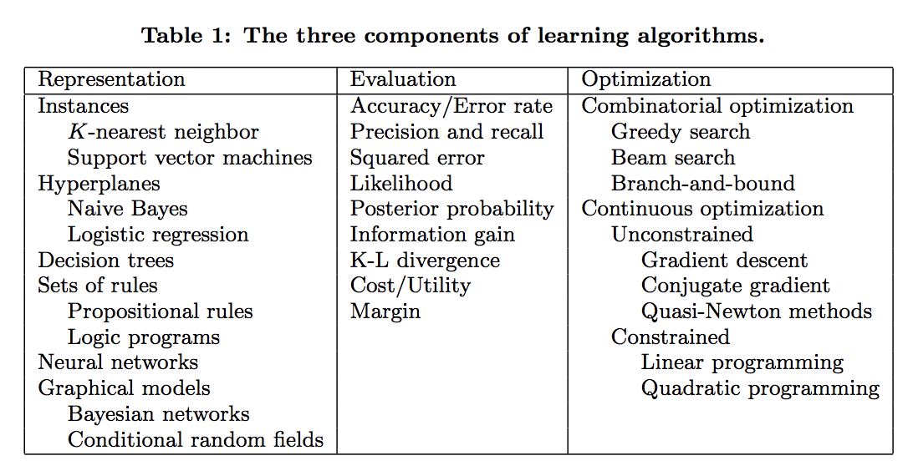
A few useful things to know about machine learning P. Domingos, CACM 2012
Learning = Representation + Evaluation + Optimization

Slide 12
Its generalization that counts!
Don’t test on training data, test on unseen/holdout data.
Overfitting: encoding random quirks in the data
A classifier that is 100% accurate on the training data but only 50% accurate on test data, when in fact it could have been 75% accurate on both,
Decompose a generalization error into bias and variance

Slide 13
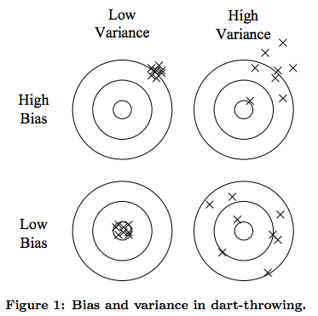
Bias and Variance
Bias: learn the same wrong thing
Variance: learn random things irrespective of real signal.
Linear learners vs Decision trees

Slide 14
Intuition fails in high dimensions: the curse of dimensionality
Generalizing correctly becomes exponentially harder as the dimensionality (number of features) of the examples grows (input space increases)
Consider Nearest Neighbor with two features (x1, x2) vs 100 features (x1,…x100) when only x1 and x2 are useful (noise from x3..x100 will swamp signals from x1, x2)
Solution: use feature selection and dimensionality reduction techniques (e.g., information gain, PCA, ..)

Slide 15
Doing Data Science
Unit 11 Machine Learning – 3
Dr. Jacquie Cheun
Data Science @ SMU

Slide 16
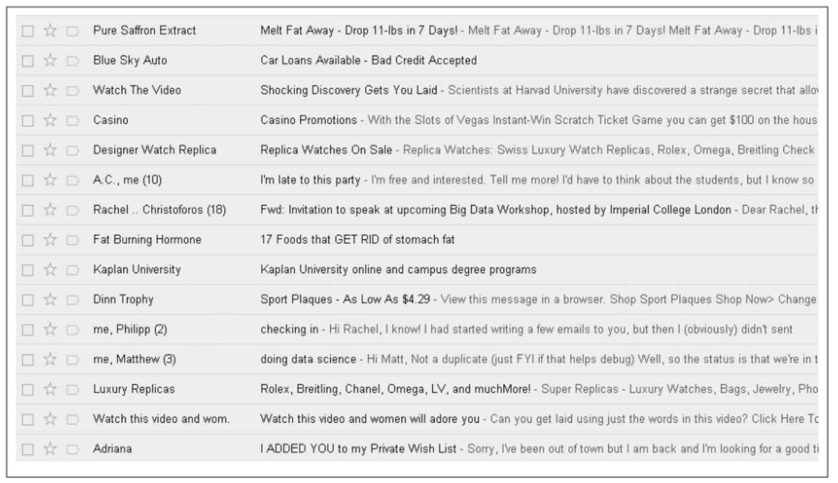
Suspiciously spammy….

Slide 17
Linear regression or kNN for spam filtering?
Linear Regression:
Presence of certain words (“Viagra”, “Rolex”, “watches”..) indicate spam
Each word can be a feature in a matrix (term-document matrix)
Linear regression will return a continuous output, not a spam/no-spam
However…too many variables to consider! (10k emails, 100k words)
kNN:
Need to define when two ”emails” are near each other
Features will be based on words
Again…too many variables to consider! (10k emails, 100k words)
Curse of Dimensionality

Slide 18
Bayes Law
Given two events x and y
P(x), P(y) = probabilities for even x and y
P(x,y) = joint probabilities (both events happen)
P(x|y) = conditional probability (even x happens given that y happens)
Bayes Law: p(y|x) = (p(x|y) p(y)) / p(x)
P(spam|word) = ( p(word|spam) p(spam)) / p(word). Note: these are counts
Non-spam aka “Ham” is 1 – p(spam) {p(spam) = all spam emails}

Slide 19
Enron example
1500 spam vs 3672 ham emails → p(spam) and p(ham)
Instances of the word ”meeting” = 16 in spam, 153 in ham
Compute the chance that an email is spam if it contains the word “meeting”
Prob(spam) = 1500/(3672 + 1500) = 0.29
Prob(ham) = 1- 0.29 = 0.71
Prob(meeting | spam) = 16/1500 = 0.0106
Prob(meeting | ham) = 153/3672 = 0.0416
Prob(spam | meeting) = prob (meeting | spam) * prob(spam) / prob(meeting)
= 0.09 = 9%

Slide 20
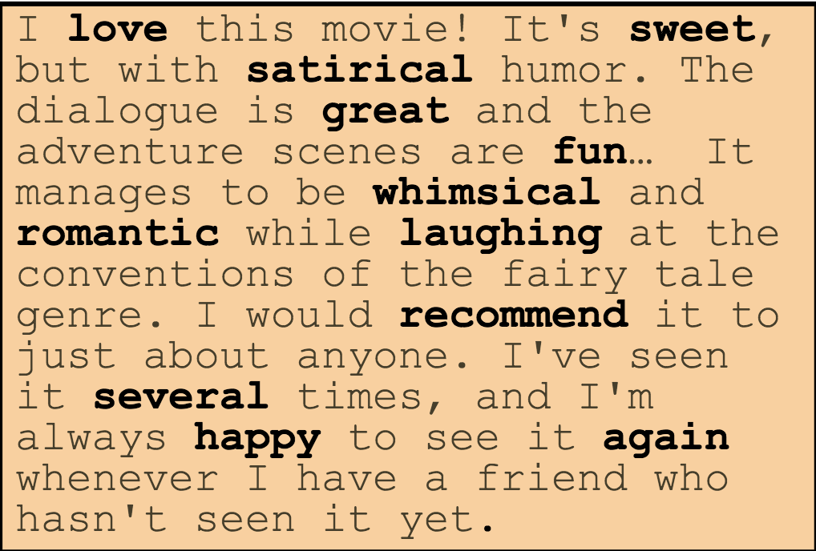
Naïve Bayes properties
Document representation: Bag of Words
E.g., a word vector for every email and word counts
Conditional independence: feature probabilities are independent for a given class (i.e., word co-occurrence is not taken into account)
Robust to noisy features and concept drift (e.g., US President)
Good efficient performance – often used as a baseline classifier

Slide 21
Can be fooled by zero frequencies: if there are no occurrences of a class label and a certain attribute value together then the frequency-based probability estimate will be zero.
E.g., many occurrences of “winner” in spam, but zero count in ham class.
Since prob(winner|ham) = 0, any email with “winner” will always be classified as spam.
Solution: Laplace smoothing, add-one smoothing

Slide 22
10 more lessons from building real-life ML systems
https://chatbotnewsdaily.com/10-more-lessons-learned-from-building-real-life-ml-systems-part-i-b309cafc7b5e
Implicit signals beat explicit ones (almost always)
"information gathered from actions not directly recognized as giving feedback by the user”.
Usually more dense + representative of all users and scenarios (e.g. product usage log)
(Usually correlates) with long-term retention
Counterexample: clickbait content → “really did not want to click on”

Slide 23
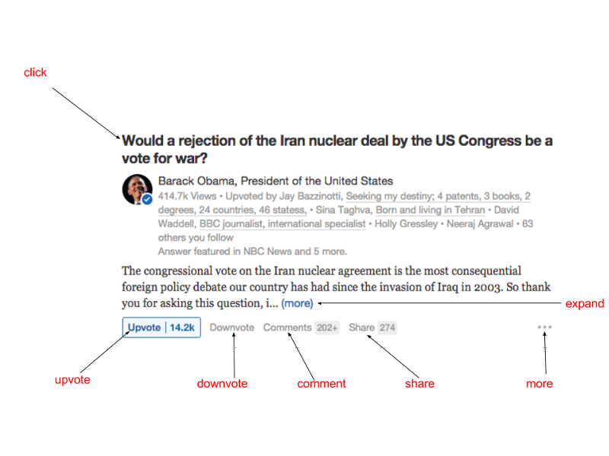
contd..
Combine implicit and explicit signals
Clicks, views, upvotes, ratings,
Optimize for short-term engagement and long-term retention

Slide 24
Your model will learn what you teach it to learn
Training data (e.g. implicit and explicit feedback on job ads)
Target function (e.g. probability of user clicking and/or applying for a job)
Metric (e.g. precision vs. recall, or any ranking metric that correlates to AB test metrics)

Slide 25
“Optimize probability of a user going to the cinema to watch a movie and rate it “highly” by using purchase history and previous ratings. Use NDCG of the ranking as final metric using only movies rated 4 or higher as positives.”

Slide 26
Supervised vs Unsupervised learning
Unsupervised learning...underutilized and underestimated?
Can be used to fight the curse of dimensionality & turn raw data into features
Matrix Factorization → semi-supervised, can also be used for dimensionality reduction ala PCA (learned factors as features)
Deep learning → RBMs, Stacked Autoencoders, etc used to pre-train Deep NNs

Slide 27
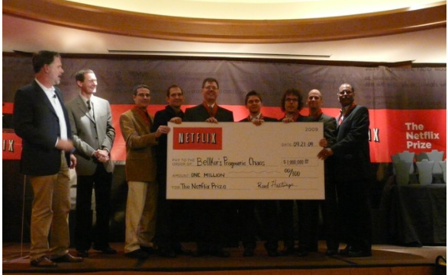
Everything is an ensemble
Netflix prize winner: an ensemble of 103 methods
A specific model might be better at predicting a particular sub-area of your problem space → a non-linear ensemble will figure it out!
Boosting
Bagging
Combination methods

Slide 28
Data dependencies and (hidden) feedback loops
**ICML 2015 keynote by L. Bottou, Facebook FAIR: http://icml.cc/2015/invited/LeonBottouICML2015.pdf
A model might be used as input to other (downstream) model
Should be robust to such potential downstream uses and accept data dependencies
E.g., for a ranking model, might be better to output rank number instead of scores
Feedback loops happen when the output of the ML model is indirectly fed into its own input.
..if you notice that some of your metrics slowly drift upwards with time even when there are no launches. https://medium.com/towards-data-science/technical-debt-in-machine-learning-8b0fae938657

Slide 29
Good machine learning features:
Reusable: Should be able to reuse features in different models, applications, and teams
Transformable: Besides directly reusing a feature, it should be easy to use a transformation of it (e.g. log(f), max(f), ∑ft over a time window…)
Interpretable: In order to do any of the previous, you need to be able to understand the meaning of features and interpret their values.
Reliable: It should be easy to monitor and detect bugs/issues in features

Slide 30
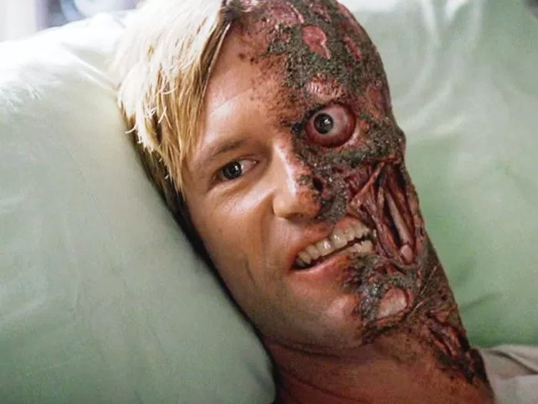
The two faces of ML infrastructure
Experimentation: flexibility, ease of use, reusability
Production: all of the above plus performance and scalability
Option 1: favor experimentation, productionize
Option 2: favor production, have researchers figure out how to run experiments

Slide 31
Both of these options do not work!
Intermediate solution(s): use the same tools as researchers in production, implement optimized versions only when needed.
Or, implement abstraction layers on top of optimized implementations

Slide 32
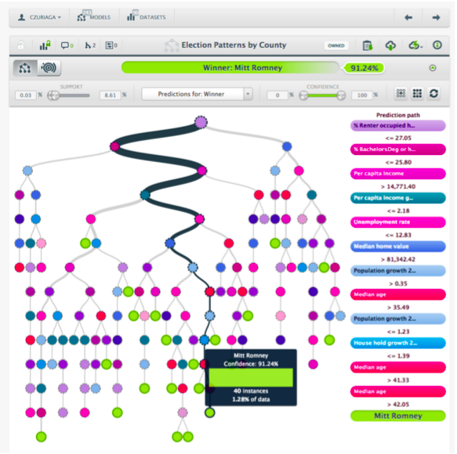
Care about answering questions about your model
http://www.cs.cmu.edu/~wcohen/10-605/debugging-tips.pdf
Value of a ML model = value it brings to a product.
Model debuggability can actually bridge the gap between product design and machine learning algorithms.
..and can influence which model, features or tools to use

Slide 33
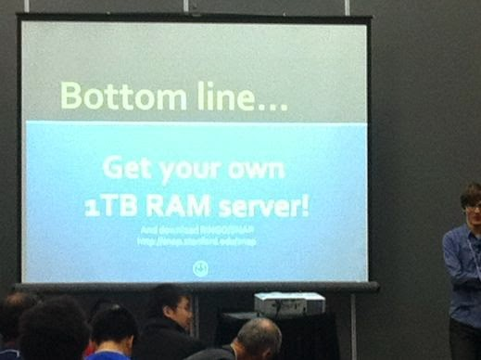
No need to distribute your ML algorithm
When and not to use distributed machine learning http://www.csie.ntu.edu.tw/~cjlin/talks/bigdata-bilbao.pdf
Most practical machine learning applications should fit into a single (multi-core) machine.
Advances still being made on how to distribute standard ML algorithms e.g Scalable k-means, wsdm’14
**existing distributed versions may not be optimized
GPUs?

Slide 34
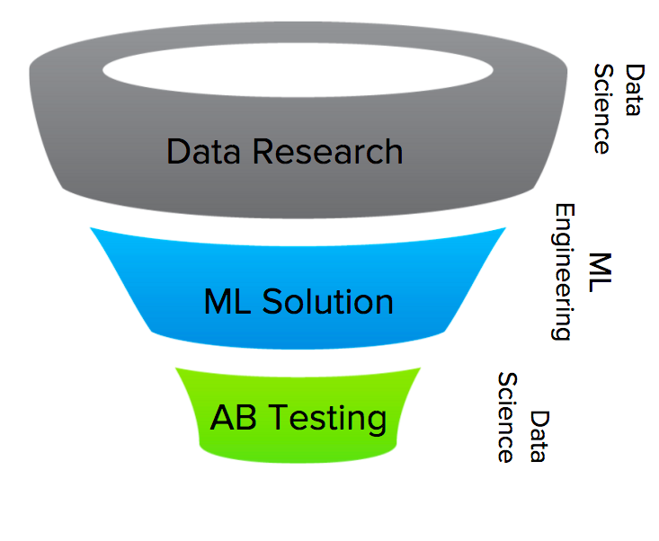
Data Science vs ML Engineering
Phases of a Data Science project:
Data research: understanding the data and the business problem
Implement an ML solution: choosing the model, feature engineering, implement in prod (ops, scaling, monitoring)
Online experiments: A/B tests, analyze the results, confirm hypothesis
data scientists + engineers bring things to production

Slide 35
What did you learn today?
Questions?

